Slide 1



ASSOC.PROF DR SHAHNORBANUN SAHRAN
THE LIFECYCLE OF AN AI PROJECT
PROJECT RELATED TO ARTIFICIAL INTELLIGENCE - TQ
PROJECT RELATED TO ARTIFICIAL INTELLIGENCE

Slide 2
TABLE OF CONTENTS
STAGE I
Planning & collecting data
STAGE II
Training your machine learning (ML) model
STAGE III
The deployment of the model
PROJECT RELATED TO ARTIFICIAL INTELLIGENCE - TQ
PROJECT RELATED TO ARTIFICIAL INTELLIGENCE

Slide 3
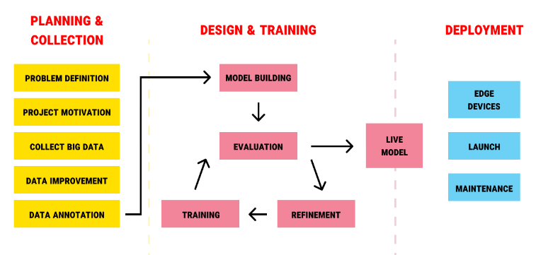
PROJECT RELATED TO ARTIFICIAL INTELLIGENCE - TQ
PROJECT RELATED TO ARTIFICIAL INTELLIGENCE

Slide 4
THE MOST IMPORTANT PART OF AI PROJECT IS “PLANNING & COLLECTING”. WHY?
1. This stage involves the planning and motivational aspects of your project. Meaning that you will need to calculate the potential profitability of the future ML model and work out the process of its adoption.
2.It’s important to start strong if you want your AI project to be successful. “Garbage in, garbage out”. This means if the collected data is not good, you won’t be able to build an effective AI algorithm.
PROJECT RELATED TO ARTIFICIAL INTELLIGENCE - TQ
PROJECT RELATED TO ARTIFICIAL INTELLIGENCE

Slide 5
PROBLEM DEFINITION
Think about the motivation for your future cognitive model.
Is there a problem it can solve?
Is there a lack of efficiency?
Or perhaps a process it can automate, so your employees can focus on more value-adding tasks?
Do you need a chatbot capable of mimicking emotion or a facial recognition model, or maybe an attendance monitoring system?
Look for the relevant, real-life use cases that your artificial intelligence project will address. Collect complaints from the users and observations from the employees
PROJECT RELATED TO ARTIFICIAL INTELLIGENCE - TQ
PROJECT RELATED TO ARTIFICIAL INTELLIGENCE

Slide 6
PROJECT MOTIVATION
You can use reference from good journals, website or any types of publications
For example: If you are working on time series data, then find a few journals related to times series with ML approach.
If you are working on medical images, then find a few journals related to medical images with ML approach.
PROJECT RELATED TO ARTIFICIAL INTELLIGENCE - TQ
PROJECT RELATED TO ARTIFICIAL INTELLIGENCE

Slide 7
DATA COLLECTION
Understanding what data your AI project requires is paramount. This is where the "garbage in, garbage out" principle plays out: if the data you collect is low-quality or insufficient, your ML model will not work most of the time.
1)Big (the more, the better)
2) Relevant (matches the problem)
3) High-quality (credible/reliable, real, and well-structured) - do data quality report & discuss with expert
Where to get data: (i) Internal sources; data that exists and is stored inside your organization
(ii) External sources : a) primary data (example: self- collected data);
b) secondary data (periodicals such as journals, newspapers, Government publications and reports)
PROJECT RELATED TO ARTIFICIAL INTELLIGENCE - TQ
PROJECT RELATED TO ARTIFICIAL INTELLIGENCE

Slide 8
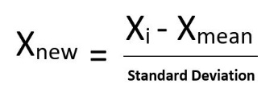

DATA IMPROVEMENT :
Machine Learning Process Steps in Data Preprocessing
Step 1 : Import the libraries
Step 2 : Import the data-set
Step 3 : Check out the missing values
Step 4 : See the Categorical Values
Step 5 : Do data quality report
Step 5 : Splitting the data-set into Training, Validation and Testing Set
Step 6 : Feature Scaling such as Min-Max normalization and standardization
Min-Max normalization -This technique re-scales a feature or observation value with distribution value between 0 and 1.
Standardisation- It is a very effective technique which re-scales a feature value so that it has distribution with 0 mean value and variance equals to 1.
Why need feature scaling?
If an algorithm is not using feature scaling method then it can consider the value 3000 meter to be greater than 5 km but that’s actually not true and in this case, the algorithm will give wrong predictions.
Example:3 features – Age, Salary, Type of Apartment. Consider a range of 10- 60 for Age, 1 200- 40 000 RM for Salary, 1- 5 for Type of Flat. It can be seen that Salary feature will dominate all other features .
PROJECT RELATED TO ARTIFICIAL INTELLIGENCE - TQ
PROJECT RELATED TO ARTIFICIAL INTELLIGENCE

Slide 9
Generalities about algorithms regarding the scaling of the data
Supervised algorithm | Unsupervised algorithm | Scaling needed?
Decision Tree |  | No
Random Forest |  | No
Naive Bayes |  | No
Linear Regression y=w1​x1​+w2​x2​+⋯+b |  | No, but sometimes very helpful
SVM (Kernel) |  | Yes
Neural Network |  | Yes
 | k-means | Yes
 | Association rules | Yes
Note: Distance-based model such as SVM, KNN, K-means, RBF kernel – Scaling is crucial Gradient-based model such as ANN – Scaling improves training speed
If scaling is not needed, it means you should not see changes between the results you obtain with or without scaling.
If it says yes, probably, it means that scaling is useful as features should have the same order of magnitude for the algorithm to work properly. However, it does not mean that performance will increase.
PROJECT RELATED TO ARTIFICIAL INTELLIGENCE - TQ
PROJECT RELATED TO ARTIFICIAL INTELLIGENCE

Slide 10
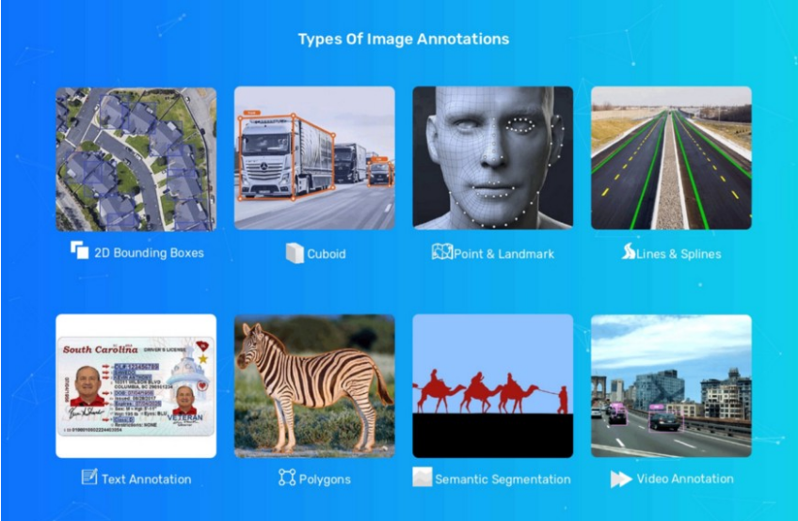
DATA ANNOTATION
The process of labeling the data available in various formats like text, video or images. For supervised machine learning labeled data sets are required, so that machine can easily and clearly understand the input patterns.
PROJECT RELATED TO ARTIFICIAL INTELLIGENCE - TQ
PROJECT RELATED TO ARTIFICIAL INTELLIGENCE

Slide 11
FINISHED WITH PLANNING & COLLECTION
PROJECT RELATED TO ARTIFICIAL INTELLIGENCE - TQ
PROJECT RELATED TO ARTIFICIAL INTELLIGENCE

Slide 12
DESIGN & TRAINING
There are several models that you can choose according to the objective that you might have: you will use algorithms of CLASSIFICATION, FORECASTING OR CLUSTERING.
Model | Applications
Logistic Regression | Price prediction
Fully connected networks | Classification
Convolutional Neural Networks | Image processing
Recurrent Neural Networks | Voice recognition
Random Forest | Fraud Detection
Reinforcement Learning | Learning by trial and error
Generative Models | Image creation
K-means | Segmentation
k-Nearest Neighbors | Recommendation systems
Bayesian Classifiers | Spam and noise filtering
PROJECT RELATED TO ARTIFICIAL INTELLIGENCE - TQ
PROJECT RELATED TO ARTIFICIAL INTELLIGENCE

Slide 13
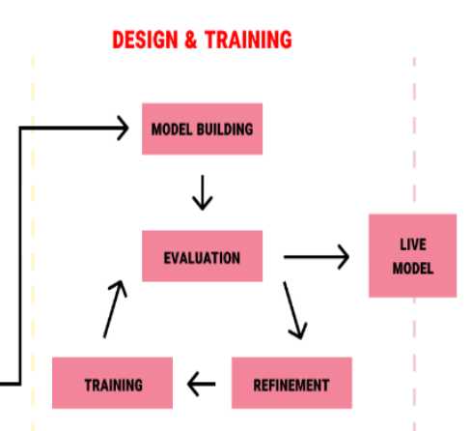
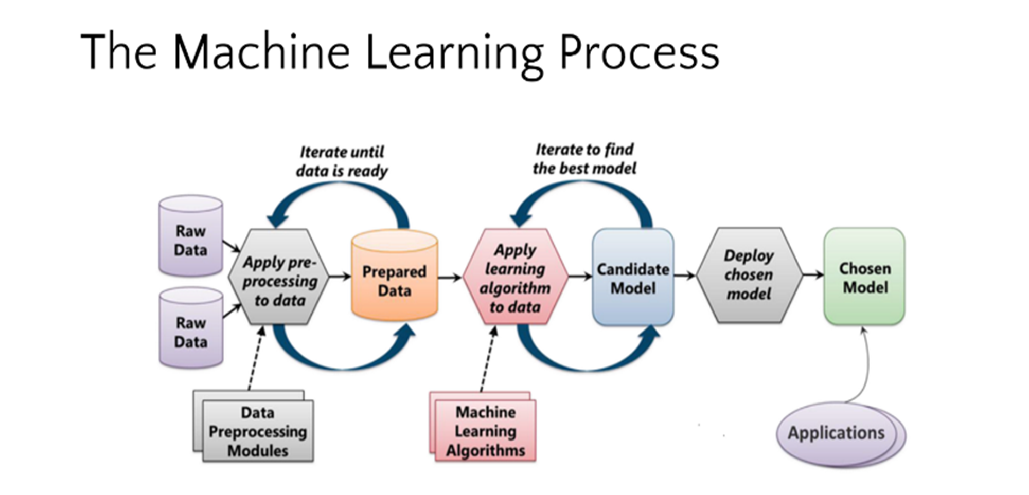
DESIGN & TRAINING
PROJECT RELATED TO ARTIFICIAL INTELLIGENCE - TQ
PROJECT RELATED TO ARTIFICIAL INTELLIGENCE

Slide 14
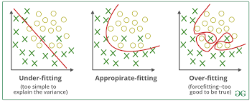
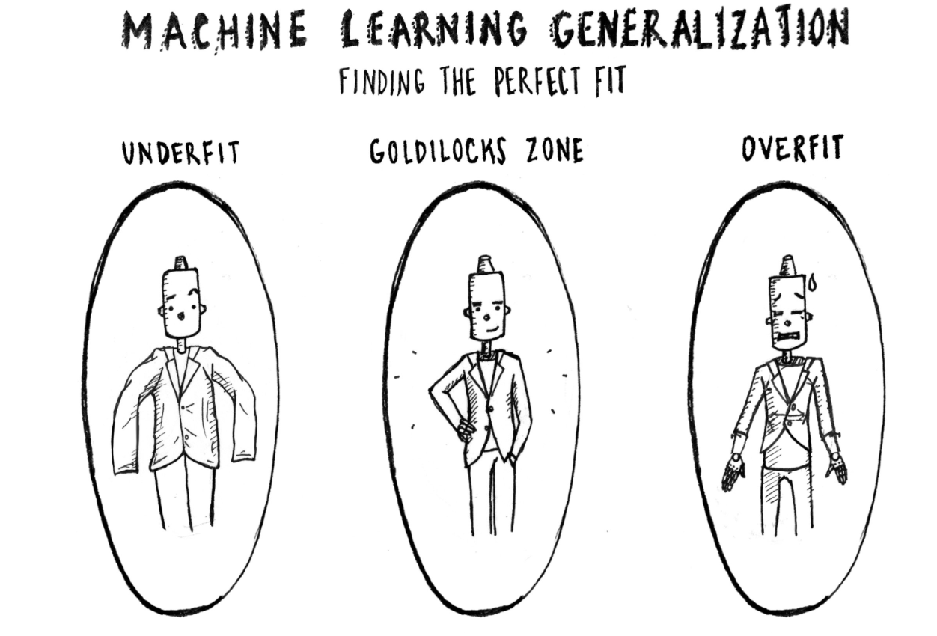
REFINEMENT OR PARAMETER TUNING
If during the evaluation you did not obtain good predictions and your precision is not the minimum desired, it is possible that you have overfitting -or underfitting problems and you must return to the training step before making a new configuration of parameters in your model. You can increase the number of times you iterate your training data- termed epochs. Another important parameter is the one known as the “learning rate”, which is usually a value that multiplies the gradient to gradually bring it closer to the global -or local- minimum to minimize the cost of the function.
PROJECT RELATED TO ARTIFICIAL INTELLIGENCE - TQ
PROJECT RELATED TO ARTIFICIAL INTELLIGENCE

Slide 15
Overfitting Underfitting Appropriate-fitting
Training 98% Training 60% Training 90%
Validation 80% Validation 58% Validation 88%
Testing 78% Testing 59% Testing 87%
- If the data set is small, just divide it to TWO portion, Training and Testing Only

Slide 16
EVALUATION
Different types of evaluation metrics available
Clustering
Internal evaluation- when true labels are NOT available. These assess how good the clusters are based on the structure of the data itself.
1) Silhouette score ; 2) Davies-Bouldin Index
External evaluation- Used when true labels ARE available (e.g., for testing or benchmarking).These compare the clustering result to actual class labels.
1) Adjusted Rand Index (ARI)
2) Normalized Mutual Information (NMI)
3) Confusion Matrix + Accuracy when labels are available, can treat clusters as classes
Classification
1) Accuracy
2) Logarithmic Loss
3) Confusion Matrix
4) Area under Curve
5) F1 Score
6) Precision and Recall
Forecasting/Prediction
Mean square error
Mean absolute error
PROJECT RELATED TO ARTIFICIAL INTELLIGENCE - TQ
PROJECT RELATED TO ARTIFICIAL INTELLIGENCE

Slide 17
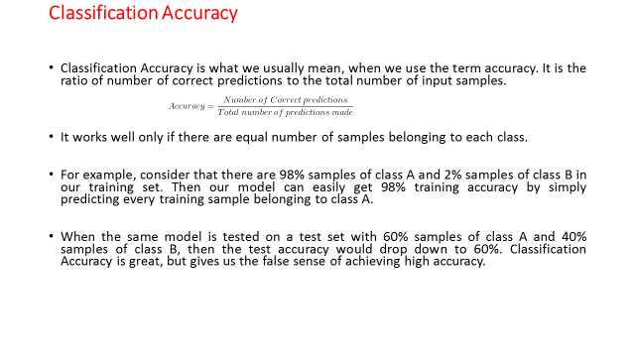
PROJECT RELATED TO ARTIFICIAL INTELLIGENCE - TQ
PROJECT RELATED TO ARTIFICIAL INTELLIGENCE

Slide 18
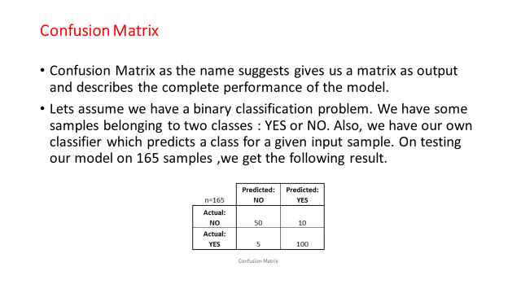
PROJECT RELATED TO ARTIFICIAL INTELLIGENCE - TQ
PROJECT RELATED TO ARTIFICIAL INTELLIGENCE

Slide 19
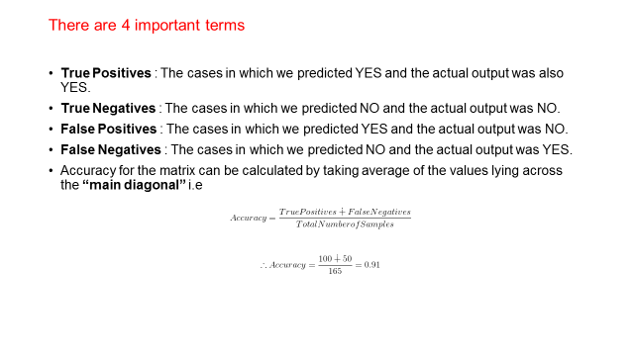
PROJECT RELATED TO ARTIFICIAL INTELLIGENCE - TQ
PROJECT RELATED TO ARTIFICIAL INTELLIGENCE

Slide 20
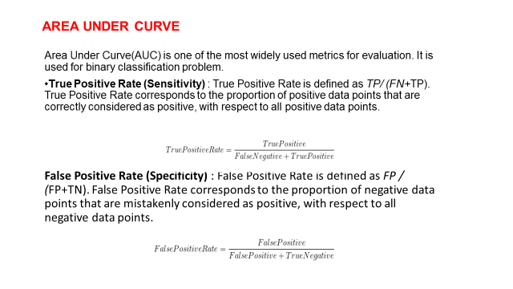
PROJECT RELATED TO ARTIFICIAL INTELLIGENCE - TQ
PROJECT RELATED TO ARTIFICIAL INTELLIGENCE

Slide 21
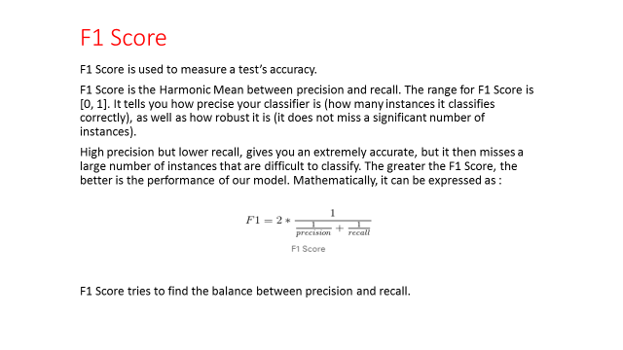
PROJECT RELATED TO ARTIFICIAL INTELLIGENCE - TQ
PROJECT RELATED TO ARTIFICIAL INTELLIGENCE

Slide 22
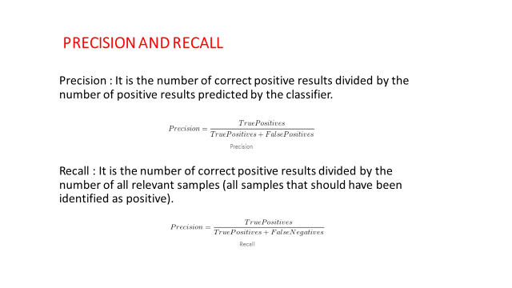
PROJECT RELATED TO ARTIFICIAL INTELLIGENCE - TQ
PROJECT RELATED TO ARTIFICIAL INTELLIGENCE

Slide 23
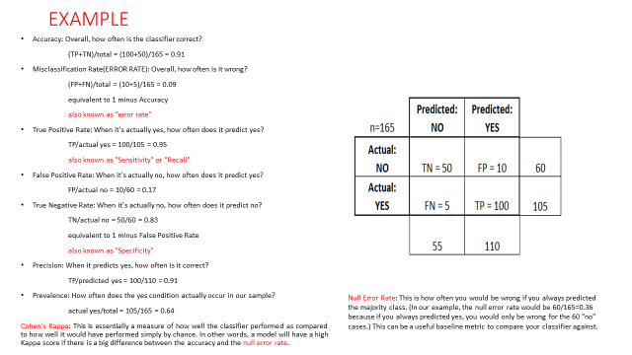
PROJECT RELATED TO ARTIFICIAL INTELLIGENCE - TQ
PROJECT RELATED TO ARTIFICIAL INTELLIGENCE

Slide 24
FINISHED WITH DESIGN & TRAINING
PROJECT RELATED TO ARTIFICIAL INTELLIGENCE - TQ
PROJECT RELATED TO ARTIFICIAL INTELLIGENCE

Slide 25

DEPLOYMENT
PROJECT RELATED TO ARTIFICIAL INTELLIGENCE - TQ
PROJECT RELATED TO ARTIFICIAL INTELLIGENCE

Slide 26
Model selection
Training for:
Model 1 = 100%
Model 2 = 100%
Model 3 = 100%
So, which ONE to choose?
You can choose any of the model based on your preference.
Model Performance Evaluation
Look at the testing result.

Slide 27
SIGNIFICANCE TEST
Comparing machine learning methods and selecting a final model is a common operation in applied machine learning.
Statistical significance tests can aid in comparing machine learning models and choosing a final model.
In the case of selecting models based on their estimated skill, we are interested to know whether there is a real or statistically significant difference between the two models.
(i) If the result of the test suggests that there is insufficient evidence to reject the null hypothesis, then any observed difference in model skill is likely due to statistical chance.
(ii) If the result of the test suggests that there is sufficient evidence to reject the null hypothesis, then any observed difference in model skill is likely due to a difference in the models.
PROJECT RELATED TO ARTIFICIAL INTELLIGENCE - TQ
PROJECT RELATED TO ARTIFICIAL INTELLIGENCE

Slide 28
THE END
PROJECT RELATED TO ARTIFICIAL INTELLIGENCE - TQ
PROJECT RELATED TO ARTIFICIAL INTELLIGENCE

